Slide 1
ML(Linear Regression)
Assignment

Slide 2
Importing the Data
At First Import all the required libraries.
After importing read.csv to read the csv file
Here the data is Housing.csv
After that will check for is there any null values and how many null values are there in the data.
Will check the data types and we’ll modify accordingly as per the requirement.
Also will check for the outliers for all the numerical columns if there is any outliers present.

Slide 3
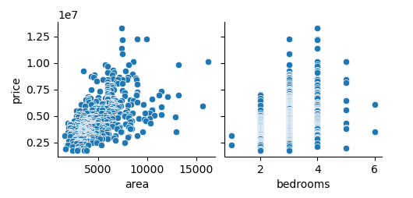
We check the columns those are having the outliers and we plot a pair plot for the exact configuration how the outliers are been there with respect to particular column/field.
Now will check the data types for the categorical columns as well.
And in the categorical columns will see the unique parameters.
And then create the dummies for the categorical columns.
After that concate/merge the cat-dummies and the numerical columns.

Slide 4
Split Data into Test & Train
Import scikit-learn library for the linear regression operation.
Split the data into train and test by 0.7 and 0.3 i.e 70% and 30% of the data.
And check by shape how the data is divided.
Then scaling the data by importing StandardScalar.
After this will train and test the data by which attribute we are looking for.
Modelling
Here we will Import the Linear Regression from sklearn to fit the train and predict the test data.
Also we will import the r2_score from sklearn-metrics to check how much similar the r2 score is the data.

Slide 5
RFE(Recursive Feature Elimination)
First of all we will import the rfe from sklearn-future selection and then fit the X and Y train data.
After checking for the data to be fit and support.
Again we will import linear regression and then see to fit the train and predict the test data.
Also we will import the r2_score from sklearn-metrics to check how much similar the r2 score is the data.
If the same r2 score occurs then will check by the Manual selection.
By OLS (ordinary least squares) we will check the train and test data by drop the columns and checking with the r-squared and the adjusted r-squared and how much of the DF Model.

Slide 6
Submitted By
Nitesh Kumar Yeddu

